Slide 1
Process Mining for HealthCare
Winter School – Impact Training on Big Data for Healthcare Systems
16th of February of 2022
Carlos Fernandez Llatas , Universitat Politecnica de Valencia

Slide 2
Contents
Processes in Healthcare
Process Mining
Interactive Process Mining

Slide 3
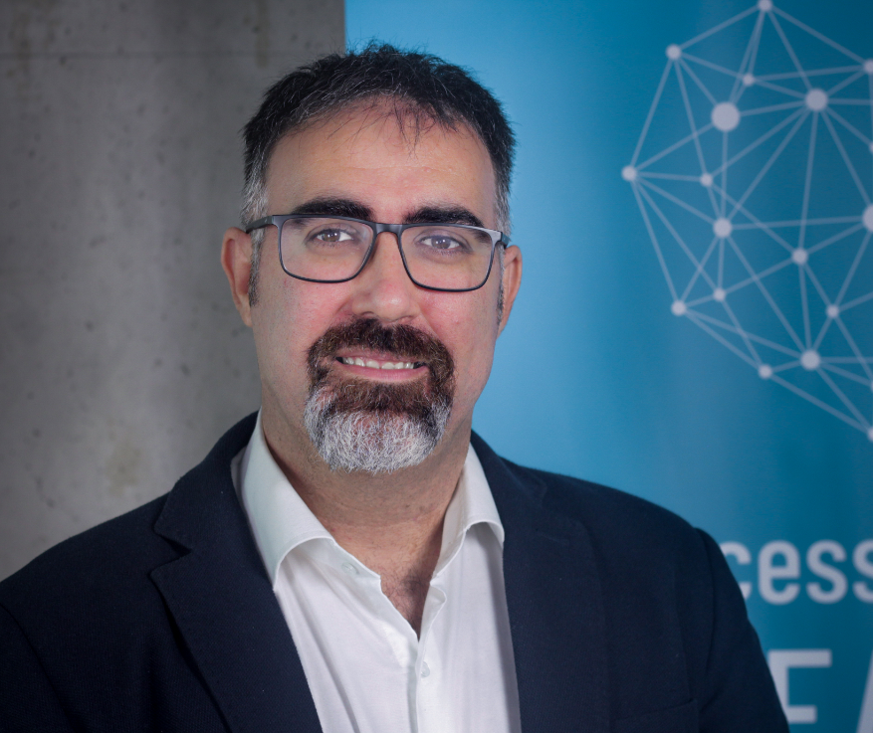
About me
Head of Process Mining 4 Health Lab at SABIEN-UPV
Deputy Director of ITACA-SABIEN-UPV
Affiliated Researcher at Department of Clinical Science, Intervention and Technology at Karolinska Institutet
PhD degree in Computer Science in the Pattern Recognition and Artificial Intelligence Program
Participation in more than 30 projects through IV to H2020 related to Health and ICT.
Founder and member of the Steering commitee in the PODS4H Alliance
Member of the IEEE Task Force on Process Mining
http://personales.upv.es/carferll/cv/
@cfllatas

Slide 4
Processes in HealthCare

Slide 5
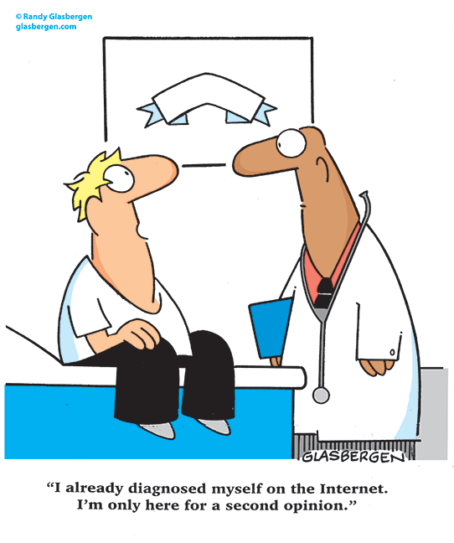
Current society
Population growth is of around 1% per year
Increase of expectance of life
More chronic illnesses
More Comorbidities
High Complexity
High Expectation of Users
Budget limitations
16/02/2022

Slide 6
Evidence Based Medicine
What the literature says
Evidence based medicine
Best research evidence
Clinical experience
Patient ‘s values
“Conscientious, explicit, and judicious use of current best evidence in making decisions about the care of individual patients”
Sackett, D. L., et al. (1996). Evidence based medicine: what it is and what it isn't.
What the patient wants
What the clinician knows
Sackett, D. L., Rosenberg, W. M., Gray, J. M., Haynes, R. B., & Richardson, W. S. (1996). Evidence based medicine: what it is and what it isn't. Bmj, 312(7023), 71-72

Slide 7
Clinical Pathways
Multidisciplinary standardized protocols
Promote formalization of experience from research for supporting daily cares
Provide well-defined standards of care
Improve clinical effectiveness, risk management, and traceability of care processes
Disseminate best practices and standards in healthcare
Reduce variability in patient care

Slide 8
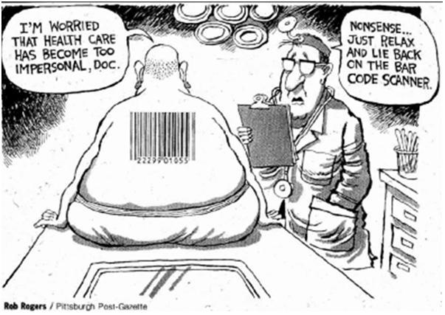
Barriers
Described by consensus of expert groups
Time consuming task
Subjective analysis
Difficult to formalize
Difference between perceived and real care process
Require adaptation and acceptance
Decrease personalisation of care

Slide 9
Process Mining

Slide 10
Process Mining
Discipline of Syntactic Data Mining that supports the Expert in processes for the proper understanding of complex processes in a Comprehensive, Objective and Exploratory way
Comprehensive
Objective
Exploratory
Fernandez-Llatas, C. (2021). Interactive Process Mining in Healthcare. Springer.

Slide 11
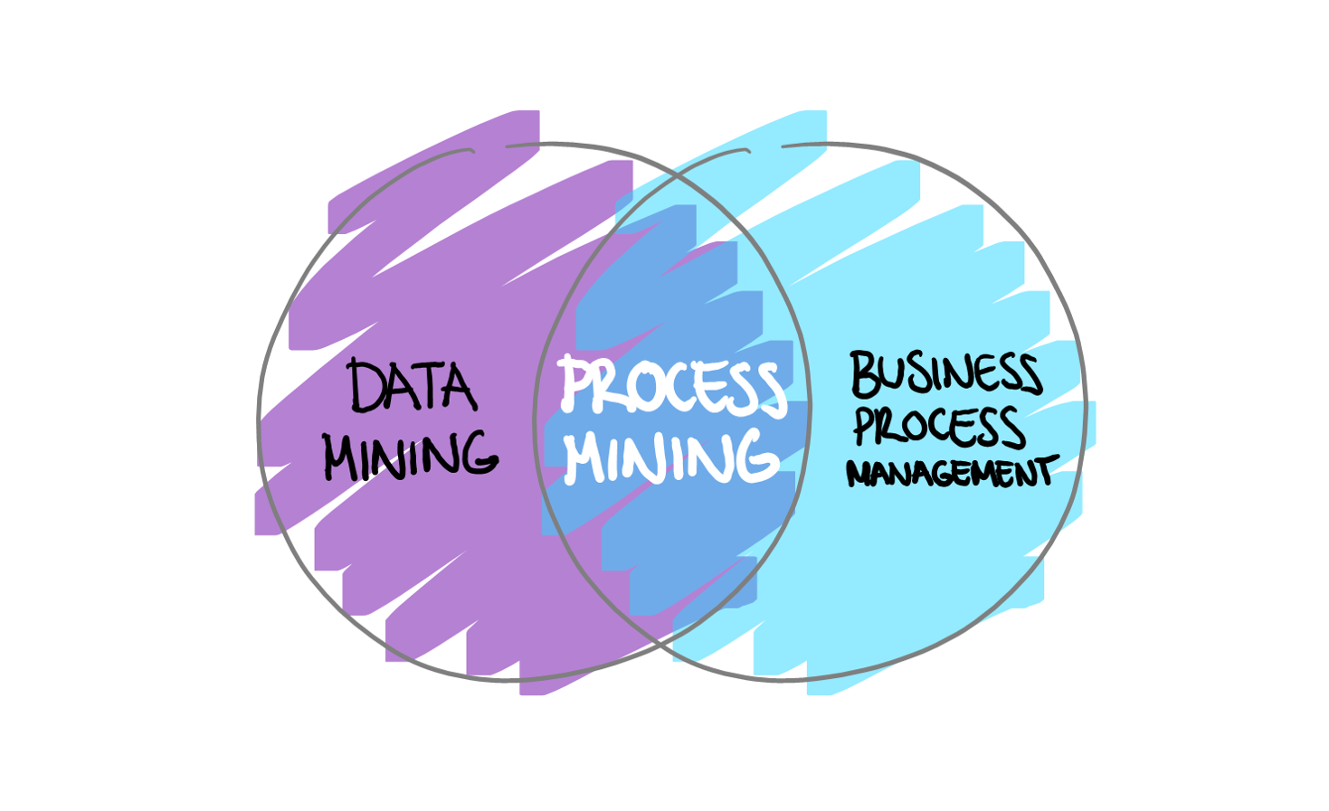
Why Process Mining?
The Process as the Center Point
Data Driven
Syntactic Data Mining
Taking into account the History
Importance of Order
Human Understandable
Explainable

Slide 12
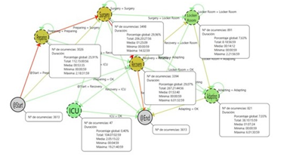
Process Mining
Trace
Log
Event
Fernandez-Llatas, C., Lizondo, A., Monton, E., Benedi, J. M., & Traver, V. (2015). Process mining methodology for health process tracking using real-time indoor location systems. Sensors, 15(12), 29821-29840..

Slide 13
Process Mining main techniques
DISCOVERY
Model
Log
Log/Model
+
CONFORMANCE
Evaluation
Model
Model
Extended Model
+
ENHANCEMENT
Context
Aalst, W. V. D., Adriansyah, A., Medeiros, A. K. A. D., Arcieri, F., Baier, T., Blickle, T., ... & Wynn, M. (2011, August). Process mining manifesto. In International conference on business process management (pp. 169-194). Springer, Berlin, Heidelberg

Slide 14
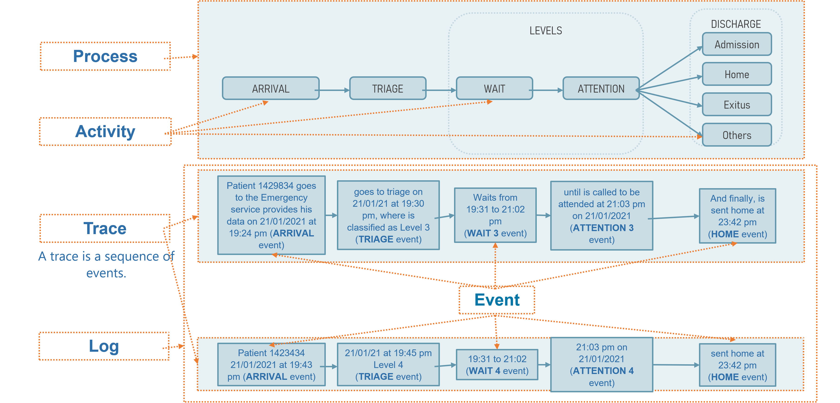
An Example: The Emergency Process in a Hospital

Slide 15
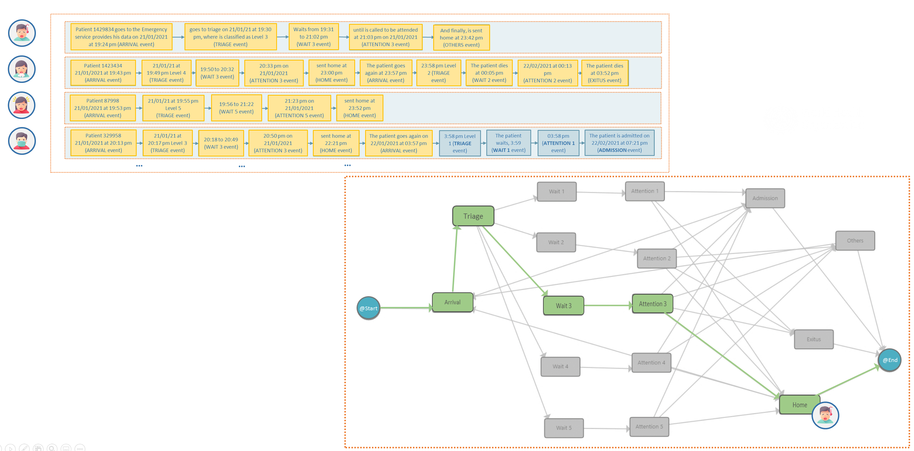
An Example: The Emergency Process in a Hospital

Slide 16
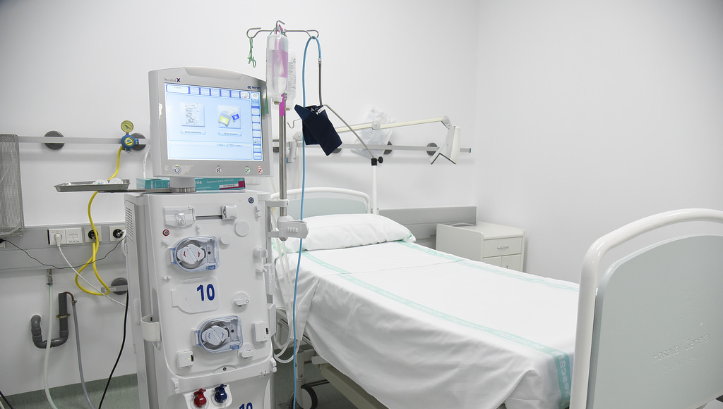
Process Mining in Surgery

Slide 17
Real Time Location Systems in Surgery

Slide 18
Fernandez-Llatas, C., Lizondo, A., Monton, E., Benedi, J. M., & Traver, V. (2015). Process mining methodology for health process tracking using real-time indoor location systems. Sensors, 15(12), 29821-29840.

Slide 19
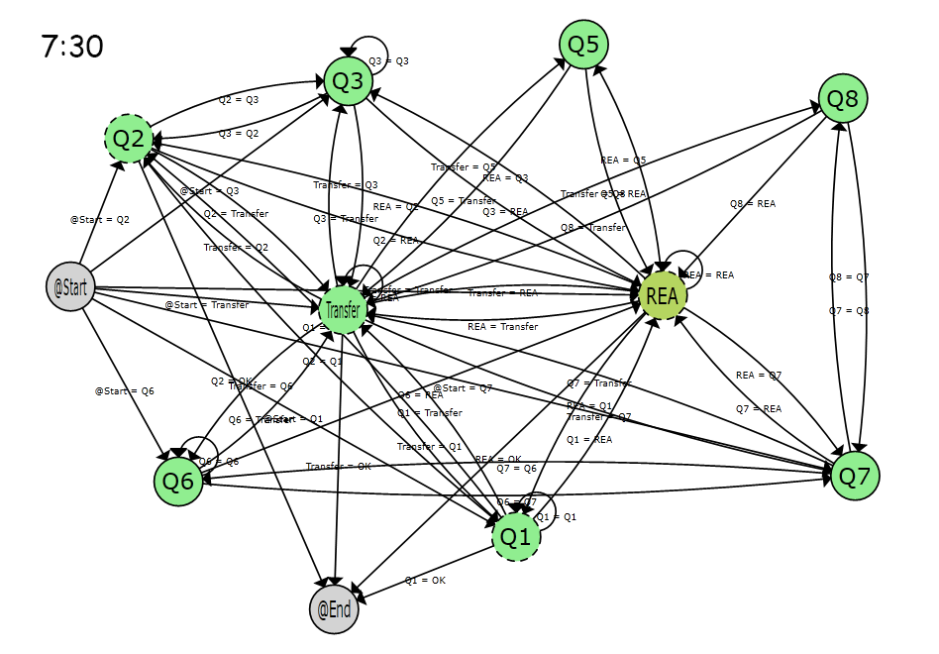

Slide 20
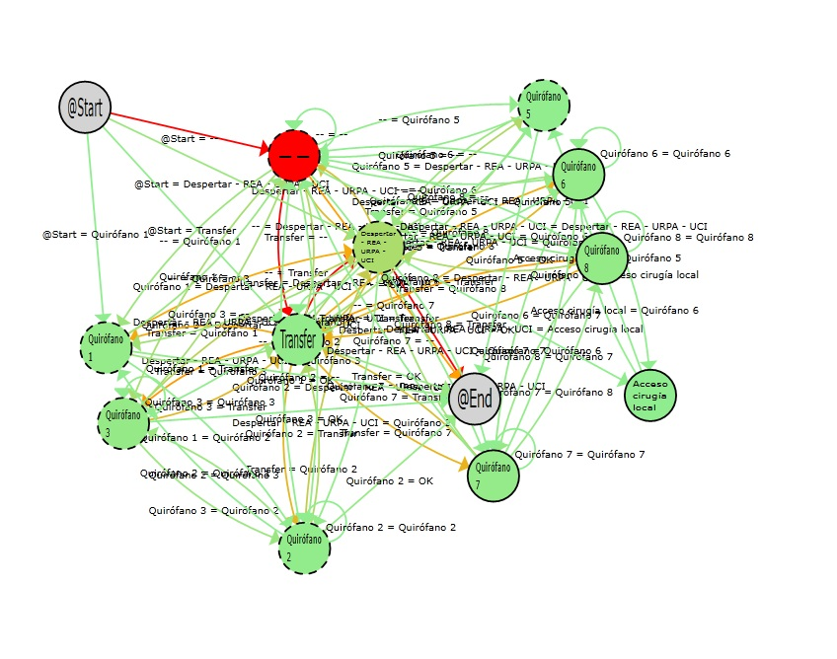
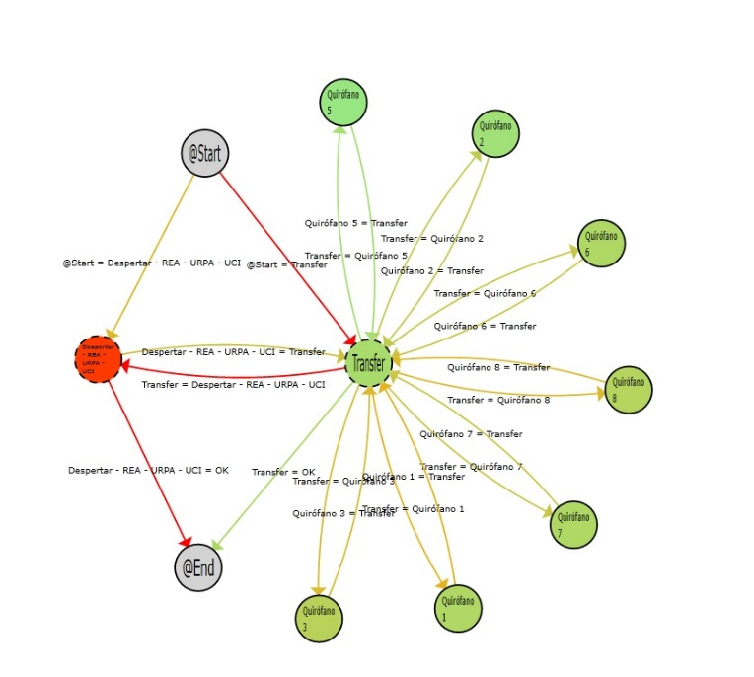
Fernandez-Llatas, C. (2021). Interactive Process Mining in Healthcare. Springer.

Slide 21
Drugs Flow

Slide 22
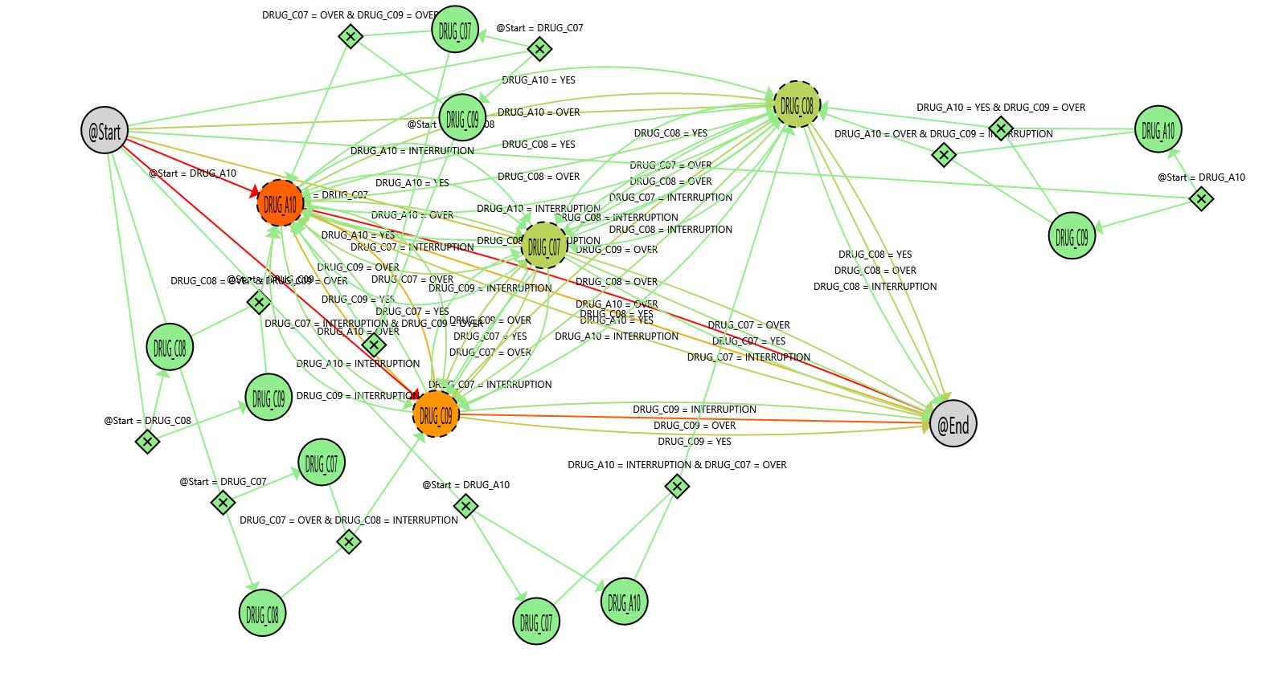
General Flow

Slide 23
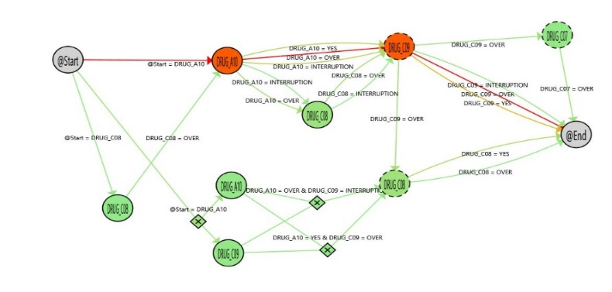
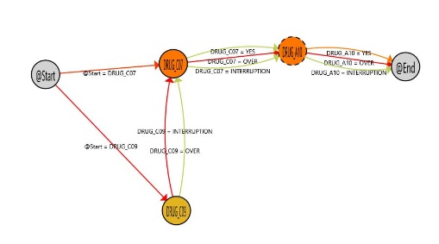
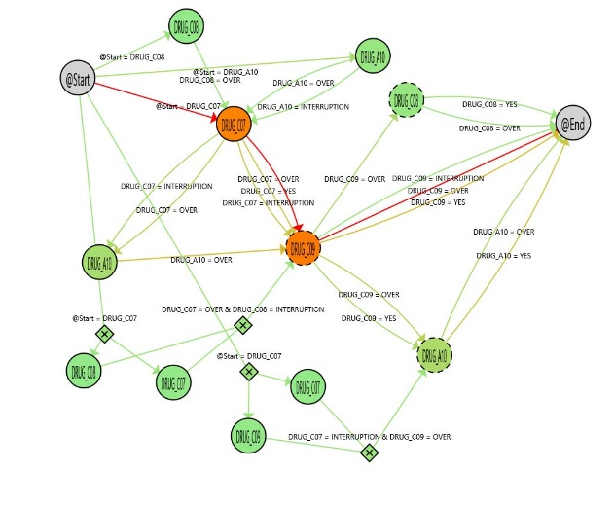
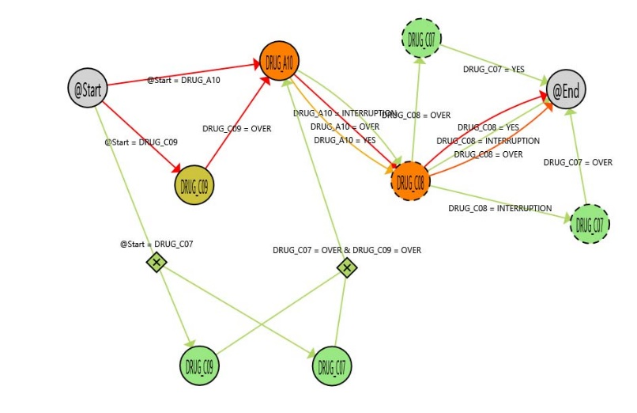
Trace Clustering

Slide 24
Interactive Process Mining

Slide 25
Cognitive Computing
Mimic Human brain
Continuous acquisition of Data
Use Machine learning techniques
Automate the Learning at the maximum
Avoid the intervention of human (as much as possible)

Slide 26
Cognitive Computing Approach
INPUT RAW DATA
Environment
OUTPUT
It is an apple!
Apple or not?
Reward
Best Action
Model Trained
Selection of Algorithm
State
Agent
Model Training
INPUT

Slide 27
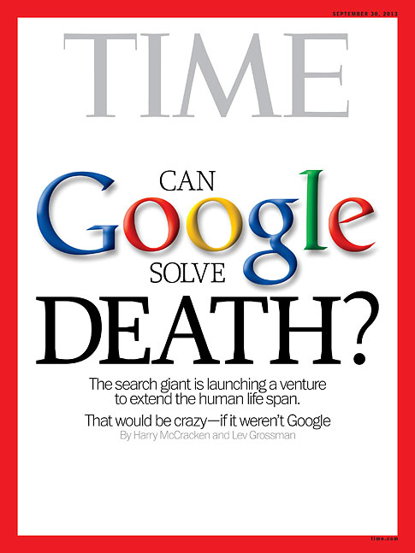
Traditional Data Science Limitations
Black Boxes
Machine Learning has an inherent error
The error is in cases with low number of samples (not standard)
The standard case is not the most interesting because is covered by the standard treatment
Not Deterministic
High variability
Affected by humans (Attitudes, beliefs of care givers, adherence of patients)
Data Quality

Slide 28
Interactive Computing
Use Human brain as a computation element
Human Computer Interaction
Control of the User
Human Understandable

Slide 29
Interactive Approach
…And has a worm
INPUT RAW DATA
Hypothesys
OUTPUT
Apple or not?
Conformance
Discovery
It is an apple!
Model Trained
Enhancement
Human knowledge Correction
What can I learn about that?
Are there other fruits?
Model Training
INPUT
Fernandez-Llatas, C. (2021). Interactive Process Mining in Healthcare. Springer.

Slide 30
Process Mining in Obesity / Malnutrition

Slide 31
NutriPro
EU Project for Analizing the malnutrition of elderly People in Nursing Homes
Data Available
Height
Periodic weight
Mini Nutritional Assessment (MNA) before and after the study (6 Months)
Problem
Analyse the behaviour of the Body Mass index (BMI) of elderly people
Compare with MNA

Slide 32
NutriPro
Valero-Ramon, Z., Fernandez-Llatas, C., Martinez-Millana, A., & Traver, V. (2019, June). A dynamic behavioral approach to nutritional assessment using process mining. In 2019 IEEE 32nd international symposium on computer-based medical systems (CBMS) (pp. 398-404). IEEE.

Slide 33
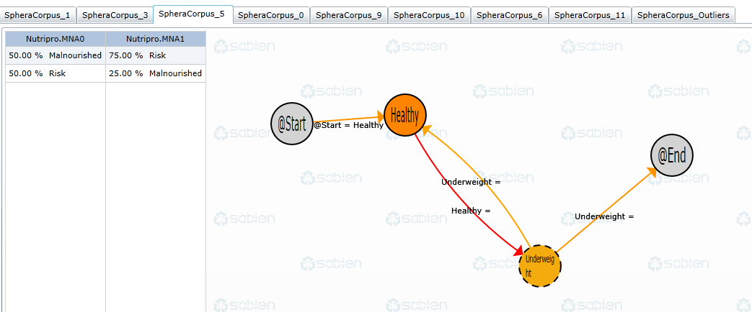
NutriPro
Valero-Ramon, Z., Fernandez-Llatas, C., Martinez-Millana, A., & Traver, V. (2019, June). A dynamic behavioral approach to nutritional assessment using process mining. In 2019 IEEE 32nd international symposium on computer-based medical systems (CBMS) (pp. 398-404). IEEE.

Slide 34
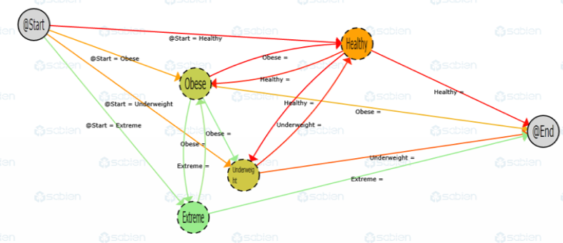
Interactive Process Indicators
Enhanced and Interactive KPIs
IPIs as a Formal Questions
Defining relative Measures
Conformance algorithms between IPIs
‘Full Crawling’.
processes ➔ Individual
Valero-Ramon, Z., Fernandez-Llatas, C., Martinez-Millana, A., & Traver, V. (2019, June). A dynamic behavioral approach to nutritional assessment using process mining. In 2019 IEEE 32nd international symposium on computer-based medical systems (CBMS) (pp. 398-404). IEEE.

Slide 35
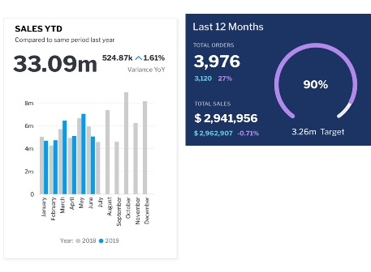
KPIs vs IPI
Key Performance Indicators
Interactive Process Indicators
Quantitative comparison
Number
Predefined Questions
Require Data Engineers
Requires assumptions about the process behavior
Qualitative & Quantitative comparison
Visual Navigable Model
Open Questions
Created mainly by Health Staff
Handle the real process

Slide 36
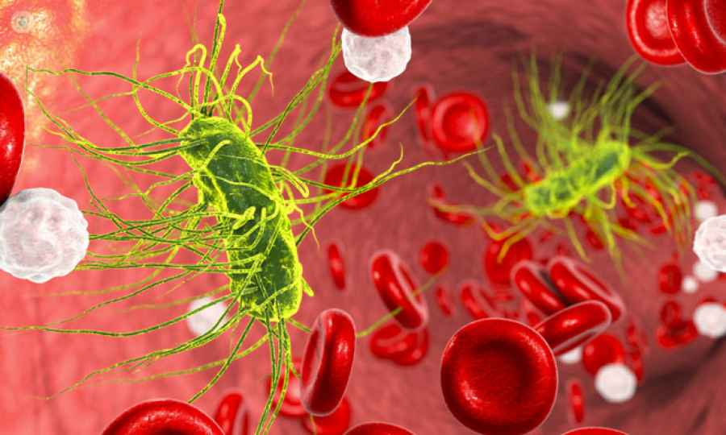
Sepsis

Slide 37
Vacuminner Project
Diagnoses Sepsis
Patients
Non-Sepsis Patients
BBDD TAIWAN
3 year diagnosis
23M patients
1B events
1.2K
> 6 months
> 50 years
4M
> 6 months
> 50 years

Slide 38
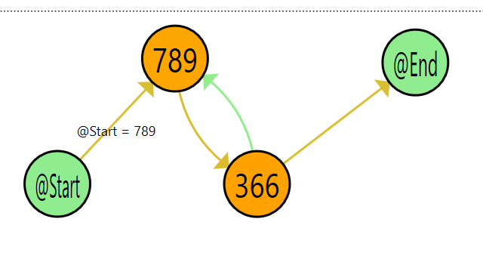
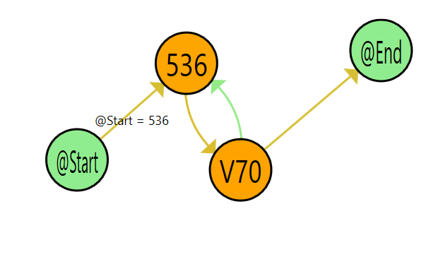
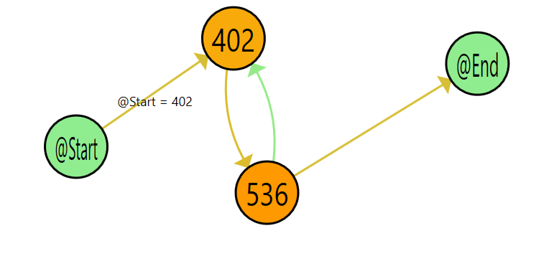
Pattern Search
304 patterns of sepsis patients not repeated in 4M non sepsis patients
Total 683 cases discovered of 1298 total cases
250(diabetes)
789(abdomen and pelvis symptoms)
366(Cataract)
24/1298 Sepsis
0/4187529 Non sepsis
272(diabetic dyslipidemia)
536(Stomach function disorders)
V70(Medical Test)
39/1298 Sepsis
0/4187529 Non sepsis
300(Anxiety, dissociative and somatomorphic disorders)
402(Hypertension)
536(Stomach function disorders)
39/1298 Sepsis
0/4187529 Non Sepsis

Slide 39
IoT / Human Behavior Modeling

Slide 40
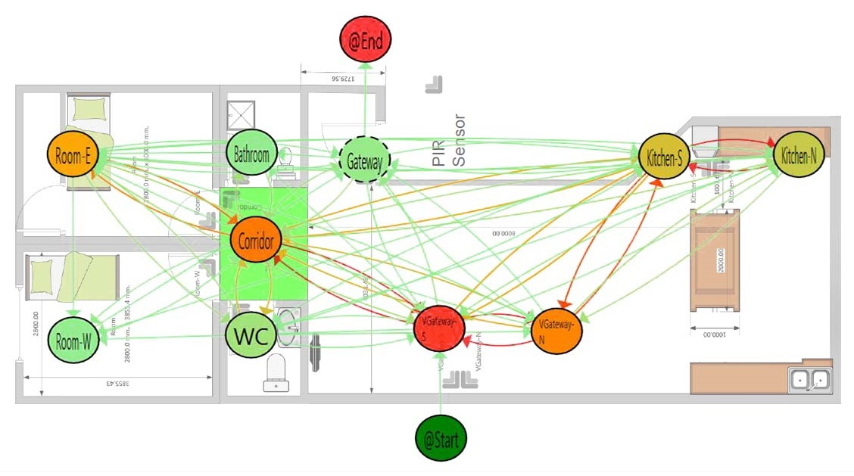

Slide 41
Different Daily Behaviors
One Day Behavior
Dogan, O., Martinez-Millana, A., Rojas, E., Sepúlveda, M., Munoz-Gama, J., Traver, V., & Fernandez-Llatas, C. (2019). Individual behavior modeling with sensors using process mining. Electronics, 8(7), 766

Slide 42
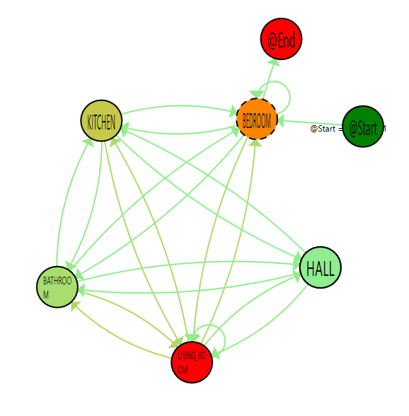
Behavioral Clusters
Dogan, O., Martinez-Millana, A., Rojas, E., Sepúlveda, M., Munoz-Gama, J., Traver, V., & Fernandez-Llatas, C. (2019). Individual behavior modeling with sensors using process mining. Electronics, 8(7), 766

Slide 43
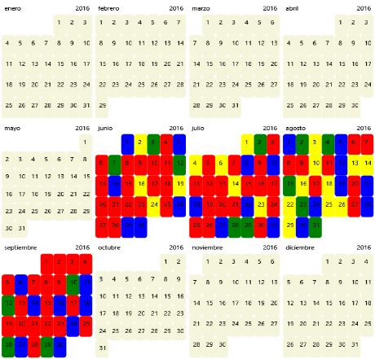
Behavioral Clusters
Dogan, O., Martinez-Millana, A., Rojas, E., Sepúlveda, M., Munoz-Gama, J., Traver, V., & Fernandez-Llatas, C. (2019). Individual behavior modeling with sensors using process mining. Electronics, 8(7), 766

Slide 44
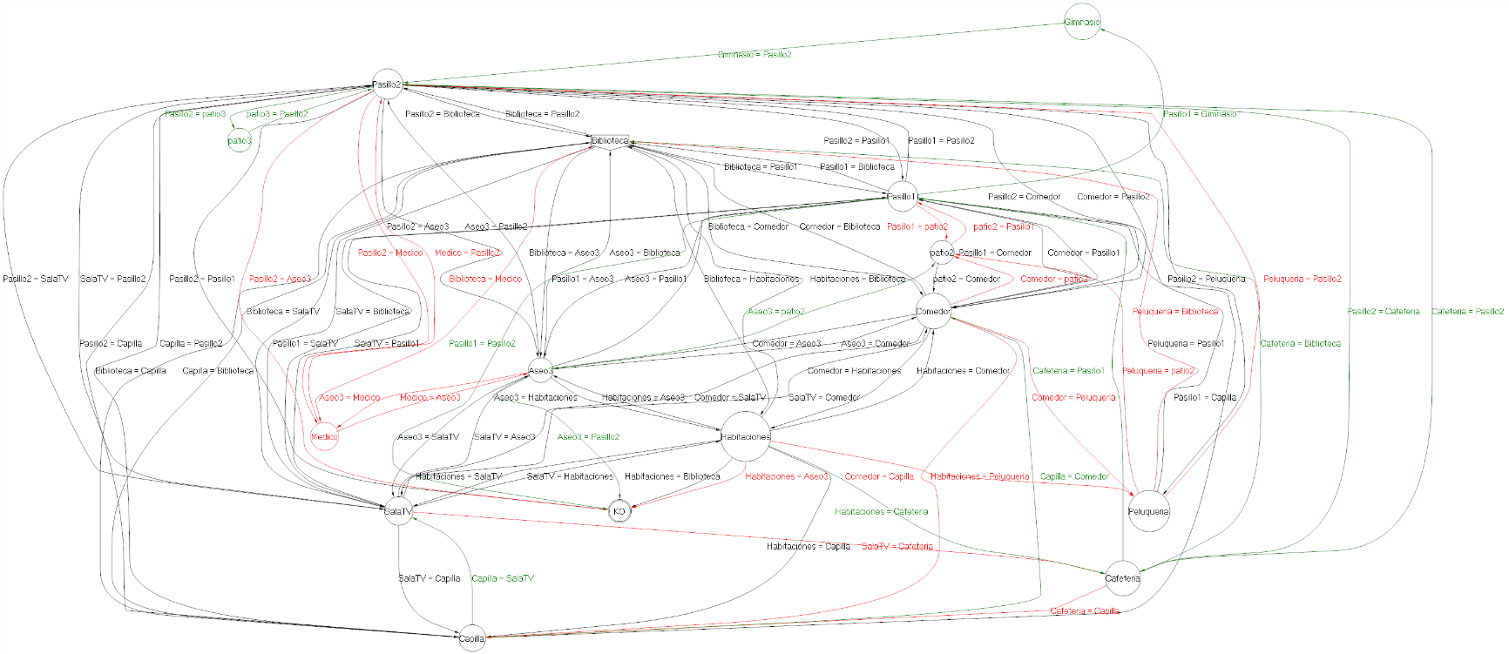
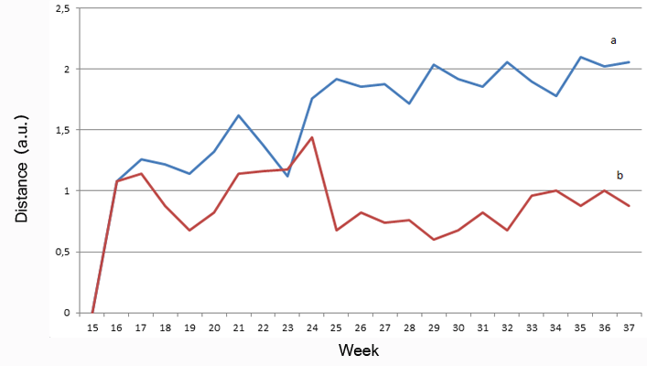
Measuring Human Behavior
Fernández-Llatas, C., Benedi, J. M., García-Gómez, J. M., & Traver, V. (2013). Process mining for individualized behavior modeling using wireless tracking in nursing homes. Sensors, 13(11), 15434-15451

Slide 45
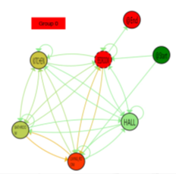
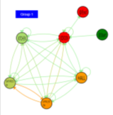
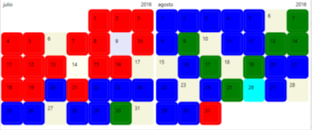
Interactive Process Mining in IoT
Raw Data
IPIs
-
IPIs Evolution
Improvement of Adherence
IPIs Abstraction

Slide 46
Emergency Rooms

Slide 47
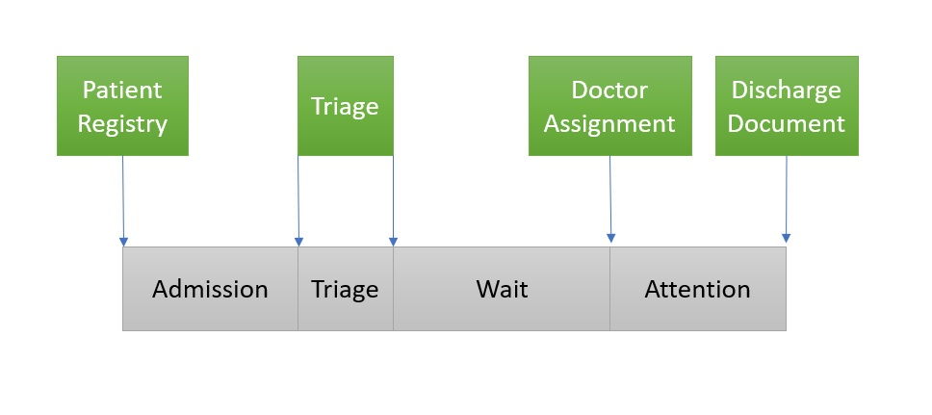
Emergency Rooms IPI
Fernandez-Llatas, C. (2021). Interactive Process Mining in Healthcare. Springer.

Slide 48
IPI Enhancement
Fernandez-Llatas, C. (2021). Interactive Process Mining in Healthcare. Springer.

Slide 49
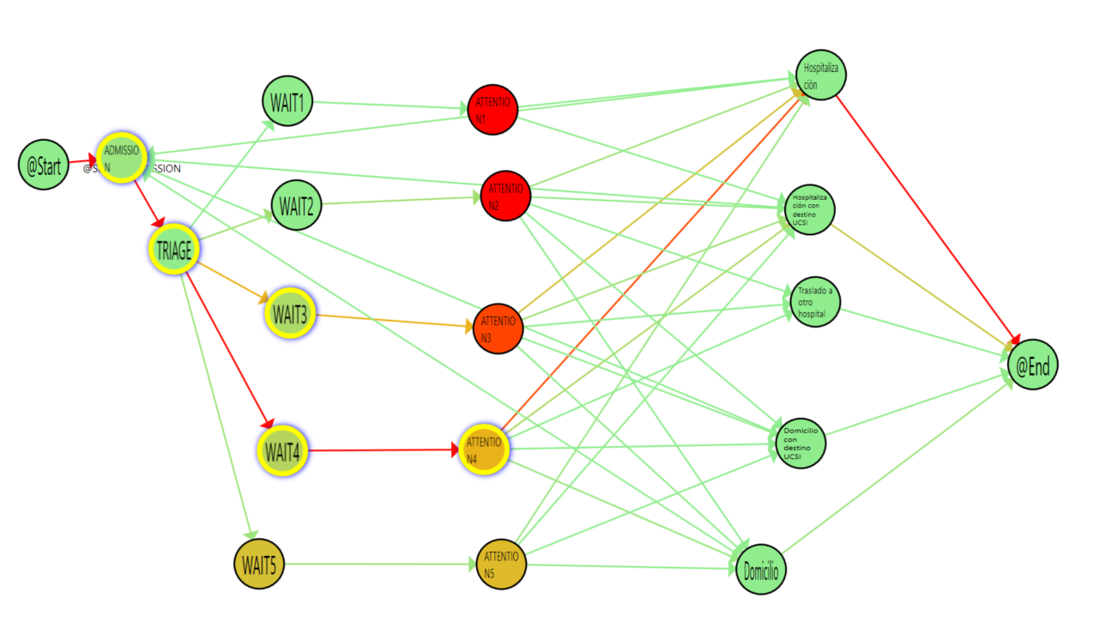
IPI Comparisons (Winter vs Summer)

Slide 50
IPI flow

Slide 51
Emergency Rooms/ Stroke

Slide 52
Stroke/non Stroke Comparison
Ibanez-Sanchez, G., Fernandez-Llatas, C., Martinez-Millana, A., Celda, A., Mandingorra, J., Aparici-Tortajada, L., ... & Traver, V. (2019). Toward value-based healthcare through interactive process mining in emergency rooms: the stroke case. International journal of environmental research and public health, 16(10), 1783

Slide 53
Analisys of Organizational Changes
Ibanez-Sanchez, G., Fernandez-Llatas, C., Martinez-Millana, A., Celda, A., Mandingorra, J., Aparici-Tortajada, L., ... & Traver, V. (2019). Toward value-based healthcare through interactive process mining in emergency rooms: the stroke case. International journal of environmental research and public health, 16(10), 1783

Slide 54
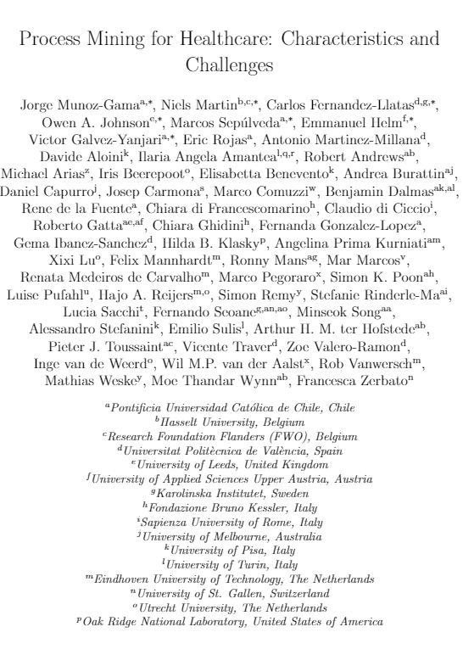
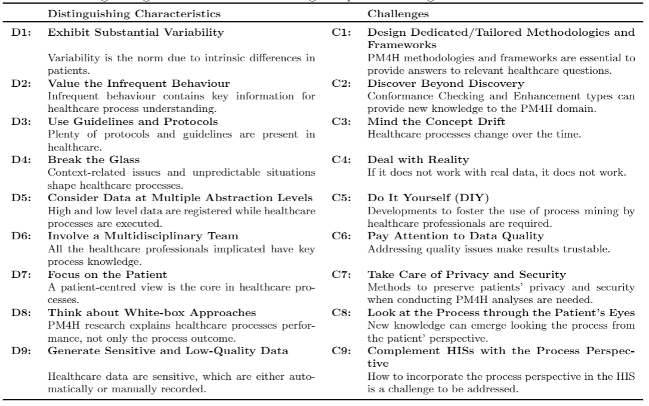
Process Mining for Healthcare Manifesto
Munoz-Gama, J., Martin, N., Fernandez-Llatas, C., Johnson, O. A., Sepúlveda, M., Helm, E., ... & Zerbato, F. (2022). Process Mining for Healthcare: Characteristics and Challenges. Journal of Biomedical Informatics, 103994.

Slide 55
Ongoing Work
VALUE-Optimizing Clinical Pathways and Patient Care Flows

Slide 56
Ongoing
MINEGUIDE

Slide 57
THANKS! QUESTIONS?
cfllatas@itaca.upv.es
carlos.fernandezllatas@ki.se
@cfllatas
http://www.sabien.upv.es/
http://pm4health.com/

